Slide 1
Designing and Analyzing Clinical Trials for Personalized Medicine via Bayesian Adaptive Design (DACTPerM)
Chuanwu Zhang
Zhang, C., Mayo, M. S., Wick, J. A., & Gajewski, B. J. (2021). Designing and analyzing clinical trials for personalized medicine via Bayesian models. Pharmaceutical Statistics, 20(3), 573-596

Slide 2
Introduction
Background
Patients with different properties may have different responses to the identical medicine.
Demographics, biomarker, risk factor, etc.
It is necessary to design a study to identify the subgroup treatment from patients, FDA and pharmaceutical industry perspective.
However, it is not easy to design such a study with routine consideration of statistical rigors.
Motivated study – PAIN-CONTRoLS
Table 1 Risk reduction in pain score by subgroup and treatment arm
Subgroup (Gender*Age) | Trt | Raw Value | Shifted Value | Std
Male Young | Arm B | 0.28 | 0.23 | 0.345
 | Arm A | 0.05 | 0 | 0.291
Male Mature | Arm B | 0.22 | 0.2 | 0.297
 | Arm A | 0.02 | 0 | 0.257
Female Young | Arm B | 0.27 | 0.06 | 0.330
 | Arm A | 0.21 | 0 | 0.303
Female Mature | Arm B | 0.24 | 0.11 | 0.284
 | Arm A | 0.13 | 0 | 0.330

Slide 3
Introduction – Cont’d
Research Big Picture
Identify the subgroup treatment effect via Bayesian adaptive design in terms of:
Bayesian models
Interim analysis involvement
Longitudinal modelling involvement
Assess the model performance by operation characteristics (OC):
Type I error
Power
Expected sample size
Study duration

Slide 4
Study Design
General Information
Data Specification
Risk reduction in pain score, continuous, higher is better.
Primary endpoint: Risk reduction in pain score at Week 12.
Proposed sample size: 400
2 arms (A&B), both are active, 200 : 200.
4 subgroups, 100 per subgroup
Table 2 response for four subgroups under six virtual treatment effect scenarios (std: 0.3)
Scenario | Arm | Sub. 1 | Sub. 2 | Sub. 3 | Sub. 4
No effect | A | 0 | 0 | 0 | 0
 | B | 0 | 0 | 0 | 0
Moderate & Homogeneous effect | A | 0 | 0 | 0 | 0
 | B | 0.17 | 0.17 | 0.17 | 0.17
Small & Homogeneous effect | A | 0 | 0 | 0 | 0
 | B | 0.085 | 0.085 | 0.085 | 0.085
Spread | A | 0 | 0 | 0 | 0
 | B | 0.05 | 0.1 | 0.2 | 0.25
Opposite | A | 0.17 | 0.17 | 0 | 0
 | B | 0 | 0 | 0.17 | 0.17
One nugget | A | 0 | 0 | 0 | 0
 | B | 0 | 0.17 | 0 | 0

Slide 5


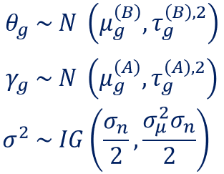
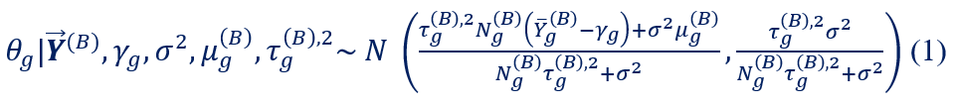
Study Design – Cont’d
Three Bayesian Models
Data specification- cont’d:
Arm A:
Arm B:
Pairwise independent model
Framework
Completely conditional distribution of interest parameters

Slide 6
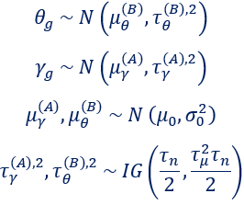
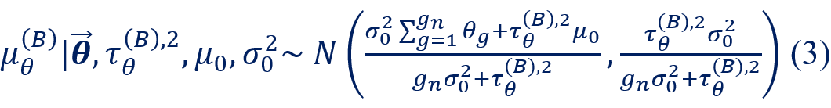
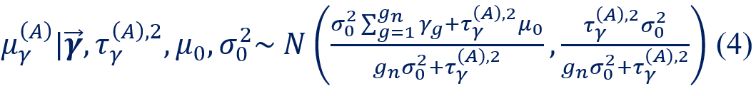
Study Design – Cont’d
Three Bayesian Models – Cont’d
Hierarchical model
Assume the priors between subgroups are exchangeable
Framework
Completely conditional distribution of interest parameters
Completely conditional distributions for $θ_{g}$ and $γ_{g}$ are identical to (1) and (2)
The parameter estimate is borrowed across the subgroups
The parameter estimate variance is smaller (shrinking) than that from data and prior

Slide 7
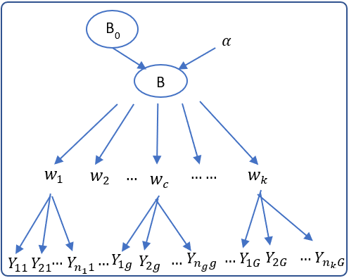

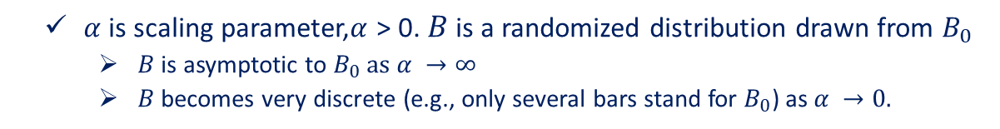
Study Design – Cont’d
Three Bayesian Models – Cont’d
Cluster hierarchical model via Dirichlet Process (DP)
$B_{0}$ is base distribution, It can be either continuous or discrete.
$α$ is scaling parameter,$α$ > 0. $B$ is a randomized distribution drawn from $B_{0}$
$B$is asymptotic to $B_{0} as α →∞$
$B$ becomes very discrete (e.g., only several bars stand for $B_{0}$) as $α →0.$
$w=\left(w_{1}…w_{c}…w_{k}\right)$ stands for the clusters; $k$ = the cluster number.
Framework for our research:
$Y_{ig}| w_{c}\sim F\left(w_{c}\right)$, $F\left(w_{c}\right)=N\left({μ_{c}|}_{w_{c}}, { τ}_{c}^{2}|_{w_{c}}\right)$
$$w_{c} \sim B$$
$B \sim DP \left(α, B_{0}\right)$, $B_{0}=N \left(μ_{0},σ_{0}^{2}\right)$

Slide 8
Study Design – Cont’d
Interim Analysis (IA)
Straightforward but important for adaptive design:
Early stop for success or futility
Adjust the study: sample size, randomization ratio, dosage, etc.
Related information:
Accrual: 4 participants/week
Drop out: 10% overall proposed sample size
Execution:
One time
½ patients enrolled

Slide 9
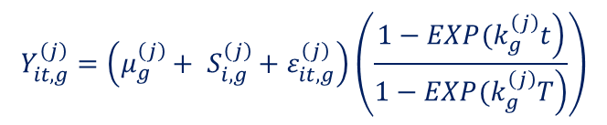
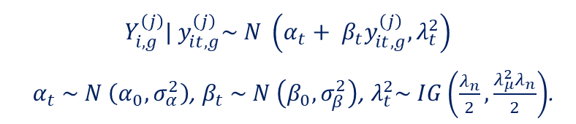
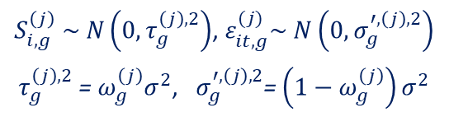
Study Design – Cont’d
Longitudinal (LG) Modelling
Visit information: Week 4, Week 8, and Week 12
Primary endpoint: Risk reduction in pain score at Week 12
Simulation
Integrated Two Component Prediction (ITP)
Imputation
Assume missing at random (MAR)
Bayesian multiple imputation
Simple Linear Regression (SLR)
$$Y_{it,g}^{\left(j\right)}=\left(μ_{g}^{\left(j\right)}+ S_{i,g}^{\left(j\right)}+ε_{it,g}^{\left(j\right)}\right)\left(\frac{\left.1−EXP(k_{g}^{\left(j\right)}t\right)}{\left.1−EXP(k_{g}^{\left(j\right)}T\right)}\right)$$
$S_{i,g}^{\left(j\right)} \sim N\left(0, τ_{g}^{\left(j\right),2}\right)$, $ε_{it,g}^{(j)}\sim N\left(0,σ_{g}^{′,\left(j\right),2}\right)$
$τ_{g}^{\left(j\right),2}$ = $ω_{g}^{\left(j\right)}σ^{2}$, $σ_{g}^{′,\left(j\right),2}$= $\left(1−ω_{g}^{\left(j\right)}\right)σ^{2}$
$$Y_{i,g}^{\left(j\right)}| y_{it,g}^{\left(j\right)}\sim N \left(α_{t}+ β_{t}y_{it,g}^{\left(j\right)}, λ_{t}^{2}\right)$$
$α_{t} \sim N \left(α_{0}, σ_{α}^{2}\right)$, $β_{t} \sim N \left(β_{0},σ_{β}^{2}\right)$, $λ_{t}^{2}\sim IG\left(\frac{λ_{n}}{2}, \frac{{λ_{μ}^{2}λ}_{n}}{2}\right)$.

Slide 10
Study Design – Cont’d
Design Choices
Factor 1 – Model:
Pairwise independent
Hierarchical
Cluster hierarchical
Factor 2 - Interim Analysis involvement:
Yes
No
Factor 3 - Longitudinal modeling involvement:
Yes
No
In total, 12 designs
Simplest: model + No Interim analysis + No Longitudinal modeling
Complicated: model + Interim analysis + Longitudinal modeling

Slide 11

Study Design – Cont’d
Bayesian Decision Rule & OC Specification
No interim analysis involved
Final Success: For some g, $P(θ_{g}>0|Data)>$ threshold
Arm B is successful
Final “Futility”: For some g, $P\left(θ_{g}<0 | Data\right)>$ threshold
Arm A is successful, since it is active arm.
Inconclusive: For all g, $P\left(θ_{g}>0 | Data\right)<$ threshold and $P\left(θ_{g}<0 | Data\right)<$ threshold.
Type I error:
Given a design under “no effect” scenario, tune the threshold to meet the type I error equal to 0.05
Power:
Apply the threshold from the same desgin for other alternative effect scenarios to have the power
Notes:
Different study designs have different thresholds.

Slide 12
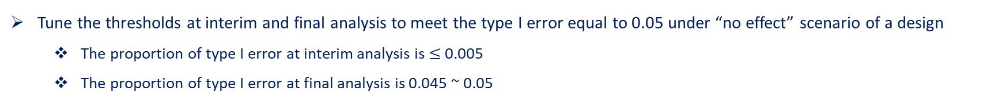
Study Design – Cont’d
Bayesian Decision Rule & OC Specification – Cont’d
Interim analysis involved
Early Success: For all g, $P(θ_{g}>0|Data)>$ threshold
Early “Futility”: For all g, $P\left(θ_{g}<0 | Data\right)>$ threshold
Arm B is successful
Arm A is successful, since it is active arm.
The definition of final success / futility / inconclusive are identical to those from no interim analysis involved
Type I error:
Tune the thresholds at interim and final analysis to meet the type I error equal to 0.05 under “no effect” scenario of a design
The proportion of type I error at interim analysis is $≤$ 0.005
The proportion of type I error at final analysis is 0.045 ~ 0.05
Power:
Apply the thresholds at interim and final analysis from the same desgin for other alternative effect scenarios to have the power

Slide 13
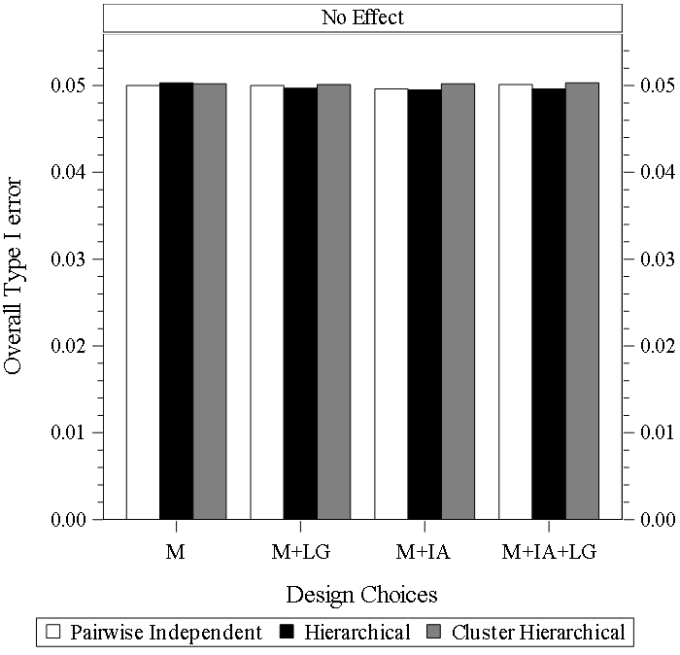
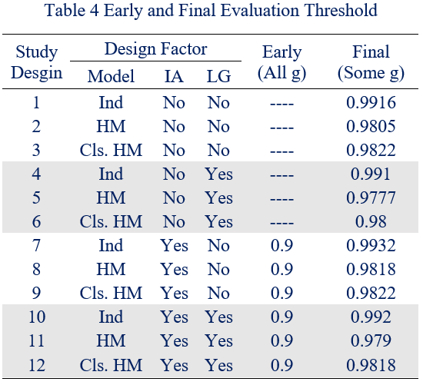

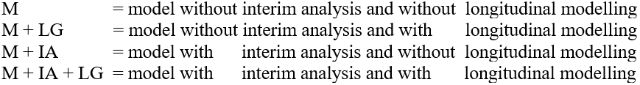
Simulation Result
Threshold & Type I error

Slide 14
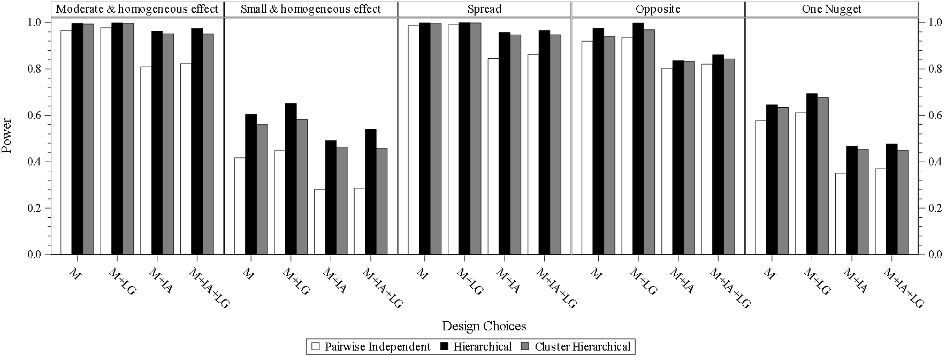
Simulation Result – cont’d
Power

Slide 15
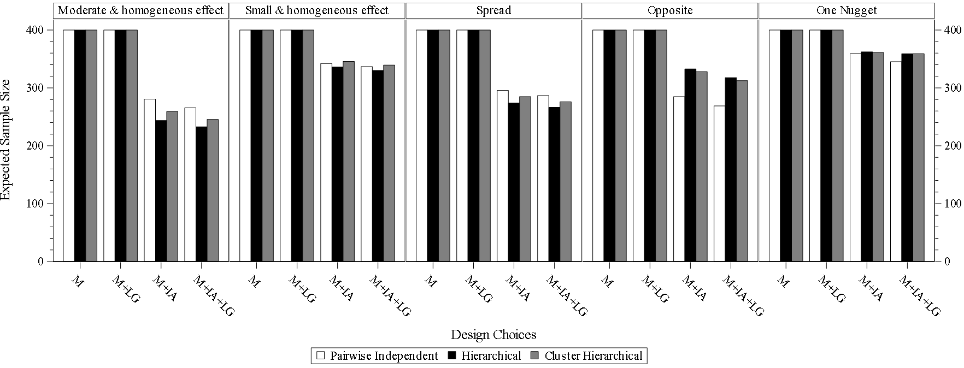
Simulation Result – cont’d
Expected Sample Size

Slide 16
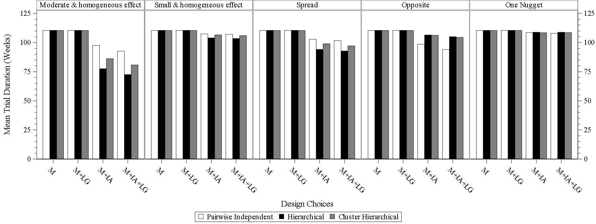
Simulation Result – cont’d
Study Duration

Slide 17
Study Design
Conclusion
Model
Hierarchical model: the good candidate due to the borrowing across all subgroups and variance shrinking.
Cluster hierarchical model: good backup, no sufficient information for priors
Pairwise independent model: straightforward, the performance is not as good as the other two
Interim analysis
Necessary consideration for adaptive design
Proportion of type I error taken on interim analysis
Decrease the expected sample size
Longitudinal modelling
Information before final data should be used
Increase the power
Decrease the expected sample size

Slide 18
Acknowledgement
This study was partially supported in part by National Institutes of Health (NIH) Clinical and Translational Science Award Grant (UL1 TR000001, formerly UL1RR033179), National Cancer Institute Cancer Center Support Grant P30 CA168524, and the Department of Biostatistics & Data Science at KUMC.

Slide 19
Thank you!
Q&A

Slide 20
Backup
Example study general information
Indication: neuropathic pain, it is usually secondary from an identified cause, like diabetes, alcohol abuse, etc.
Medicine: pregabalin (A) & nortriptyline (B)
Primary Endpoint: Risk reduction in pain score
Objective: Determine which drug is most effective in reducing the pain in patient with neuropathic pain
Analysis model/Design: Bayesian Response Adaptive Randomization (RAR)

Slide 21
Backup- simulation result - Power
Scenario: Mod.& Homo.
model | IA | LG | Power
InD | No | No | 0.9656
HM | No | No | 0.997
Cls.HM | No | No | 0.9939
InD | No | Yes | 0.9778
HM | No | Yes | 0.9984
Cls.HM | No | Yes | 0.9966
InD | Yes | No | 0.8091
HM | Yes | No | 0.9629
Cls.HM | Yes | No | 0.9514
InD | Yes | Yes | 0.8235
HM | Yes | Yes | 0.9752
Cls.HM | Yes | Yes | 0.9509
Scenario: Small & homo.
model | IA | LG | Power
InD | No | No | 0.4168
HM | No | No | 0.6043
Cls.HM | No | No | 0.5609
InD | No | Yes | 0.448
HM | No | Yes | 0.6516
Cls.HM | No | Yes | 0.5831
InD | Yes | No | 0.2803
HM | Yes | No | 0.4916
Cls.HM | Yes | No | 0.4634
InD | Yes | Yes | 0.2856
HM | Yes | Yes | 0.5396
Cls.HM | Yes | Yes | 0.458
Scenario: Spread
model | IA | LG | Power
InD | No | No | 0.9871
HM | No | No | 0.9984
Cls.HM | No | No | 0.9963
InD | No | Yes | 0.9906
HM | No | Yes | 0.9995
Cls.HM | No | Yes | 0.9985
InD | Yes | No | 0.8454
HM | Yes | No | 0.9575
Cls.HM | Yes | No | 0.947
InD | Yes | Yes | 0.8615
HM | Yes | Yes | 0.9664
Cls.HM | Yes | Yes | 0.9471
Scenario: Opposite
model | IA | LG | Power
InD | No | No | 0.9197
HM | No | No | 0.9757
Cls.HM | No | No | 0.9412
InD | No | Yes | 0.9361
HM | No | Yes | 0.9981
Cls.HM | No | Yes | 0.969
InD | Yes | No | 0.803
HM | Yes | No | 0.8356
Cls.HM | Yes | No | 0.8314
InD | Yes | Yes | 0.8209
HM | Yes | Yes | 0.8608
Cls.HM | Yes | Yes | 0.8433
Scenario: One Nugget
model | IA | LG | Power
InD | No | No | 0.5774
HM | No | No | 0.6456
Cls.HM | No | No | 0.6337
InD | No | Yes | 0.6111
HM | No | Yes | 0.6934
Cls.HM | No | Yes | 0.6771
InD | Yes | No | 0.3509
HM | Yes | No | 0.4665
Cls.HM | Yes | No | 0.4542
InD | Yes | Yes | 0.3696
HM | Yes | Yes | 0.4759
Cls.HM | Yes | Yes | 0.4498

Slide 22
Backup- Simulation Result - Expected Sample Size
Scenario: Mod.& Homo.
model | IA | LG | Exp. SS
InD | No | No | 400
HM | No | No | 400
Cls.HM | No | No | 400
InD | No | Yes | 400
HM | No | Yes | 400
Cls.HM | No | Yes | 400
InD | Yes | No | 280.675
HM | Yes | No | 243.572
Cls.HM | Yes | No | 259.152
InD | Yes | Yes | 265.534
HM | Yes | Yes | 232.749
Cls.HM | Yes | Yes | 245.572
Scenario: Small & homo.
model | IA | LG | Exp. SS
InD | No | No | 400
HM | No | No | 400
Cls.HM | No | No | 400
InD | No | Yes | 400
HM | No | Yes | 400
Cls.HM | No | Yes | 400
InD | Yes | No | 342.140
HM | Yes | No | 336.088
Cls.HM | Yes | No | 345.800
InD | Yes | Yes | 336.800
HM | Yes | Yes | 330.057
Cls.HM | Yes | Yes | 339.323
Scenario: Spread
model | IA | LG | Exp. SS
InD | No | No | 400
HM | No | No | 400
Cls.HM | No | No | 400
InD | No | Yes | 400
HM | No | Yes | 400
Cls.HM | No | Yes | 400
InD | Yes | No | 295.782
HM | Yes | No | 273.741
Cls.HM | Yes | No | 284.955
InD | Yes | Yes | 286.861
HM | Yes | Yes | 266.355
Cls.HM | Yes | Yes | 275.973
Scenario: Opposite
model | IA | LG | Exp. SS
InD | No | No | 400
HM | No | No | 400
Cls.HM | No | No | 400
InD | No | Yes | 400
HM | No | Yes | 400
Cls.HM | No | Yes | 400
InD | Yes | No | 284.859
HM | Yes | No | 332.829
Cls.HM | Yes | No | 327.913
InD | Yes | Yes | 268.911
HM | Yes | Yes | 317.732
Cls.HM | Yes | Yes | 312.550
Scenario: One Nugget
model | IA | LG | Exp. SS
InD | No | No | 400
HM | No | No | 400
Cls.HM | No | No | 400
InD | No | Yes | 400
HM | No | Yes | 400
Cls.HM | No | Yes | 400
InD | Yes | No | 358.892
HM | Yes | No | 362.278
Cls.HM | Yes | No | 361.148
InD | Yes | Yes | 345.263
HM | Yes | Yes | 359.011
Cls.HM | Yes | Yes | 358.892

Slide 23
Backup - Simulation Result - Study Duration
Scenario: Mod.& Homo.
model | IA | LG | Study Dur.
InD | No | No | 110.44
HM | No | No | 110.49
Cls.HM | No | No | 110.45
InD | No | Yes | 110.49
HM | No | Yes | 110.53
Cls.HM | No | Yes | 110.45
InD | Yes | No | 97.58
HM | Yes | No | 77.55
Cls.HM | Yes | No | 86.23
InD | Yes | Yes | 92.70
HM | Yes | Yes | 72.52
Cls.HM | Yes | Yes | 80.83
Scenario: Small & homo.
model | IA | LG | Study Dur.
InD | No | No | 110.44
HM | No | No | 110.49
Cls.HM | No | No | 110.45
InD | No | Yes | 110.49
HM | No | Yes | 110.53
Cls.HM | No | Yes | 110.45
InD | Yes | No | 107.49
HM | Yes | No | 104.05
Cls.HM | Yes | No | 106.63
InD | Yes | Yes | 107.11
HM | Yes | Yes | 103.54
Cls.HM | Yes | Yes | 106.03
Scenario: Spread
model | IA | LG | Study Dur.
InD | No | No | 110.44
HM | No | No | 110.49
Cls.HM | No | No | 110.45
InD | No | Yes | 110.49
HM | No | Yes | 110.53
Cls.HM | No | Yes | 110.45
InD | Yes | No | 102.90
HM | Yes | No | 94.21
Cls.HM | Yes | No | 99.02
InD | Yes | Yes | 101.72
HM | Yes | Yes | 92.81
Cls.HM | Yes | Yes | 97.19
Scenario: Opposite
model | IA | LG | Study Dur.
InD | No | No | 110.44
HM | No | No | 110.49
Cls.HM | No | No | 110.45
InD | No | Yes | 110.49
HM | No | Yes | 110.53
Cls.HM | No | Yes | 110.45
InD | Yes | No | 98.66
HM | Yes | No | 106.54
Cls.HM | Yes | No | 106.32
InD | Yes | Yes | 94.07
HM | Yes | Yes | 105.06
Cls.HM | Yes | Yes | 104.50
Scenario: One Nugget
model | IA | LG | Study Dur.
InD | No | No | 110.44
HM | No | No | 110.49
Cls.HM | No | No | 110.45
InD | No | Yes | 110.49
HM | No | Yes | 110.53
Cls.HM | No | Yes | 110.45
InD | Yes | No | 108.66
HM | Yes | No | 108.95
Cls.HM | Yes | No | 108.51
InD | Yes | Yes | 108.02
HM | Yes | Yes | 108.89
Cls.HM | Yes | Yes | 108.66

Slide 24
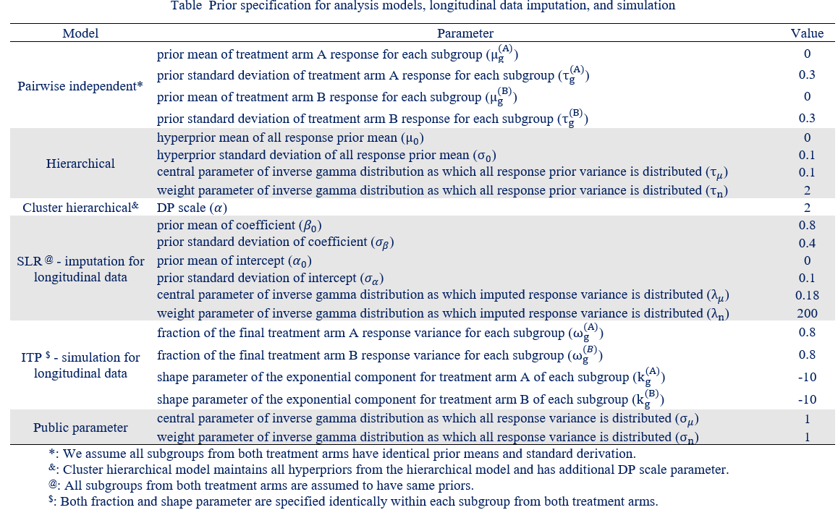
Backup
Prior and ITP Setting

